Slide 1




IHE on FHIR
John Moehrke
By Light Professional IT Services LLC
August 18, 2022

Slide 2
IHE Domains
Cardiology
Dental
Eye Care
IT Infrastructure (ITI)
Pathology and Laboratory Medicine
Patient Care Coordination
Devices
Pharmacy
Quality, Research and Public Health
Radiation Oncology
Radiology
* Marked in red are domains using FHIR
Source: https://www.ihe.net/IHE_Domains/
Notes:
11 domains, 8 have some Implementation Guide (aka Profile) using FHIR.

Slide 3
Mobile
Fallacy - All profiles from IHE that leverage FHIR have the word “Mobile” in their title.
Usually only used when historic use-case is re-evaluated using FHIR (PDQ vs PDQ3 vs PDQm)
Mobile - Does NOT restrict the use to only Mobile
Server to server can use Mobile and FHIR
Big systems can be FHIR clients and servers

Slide 4
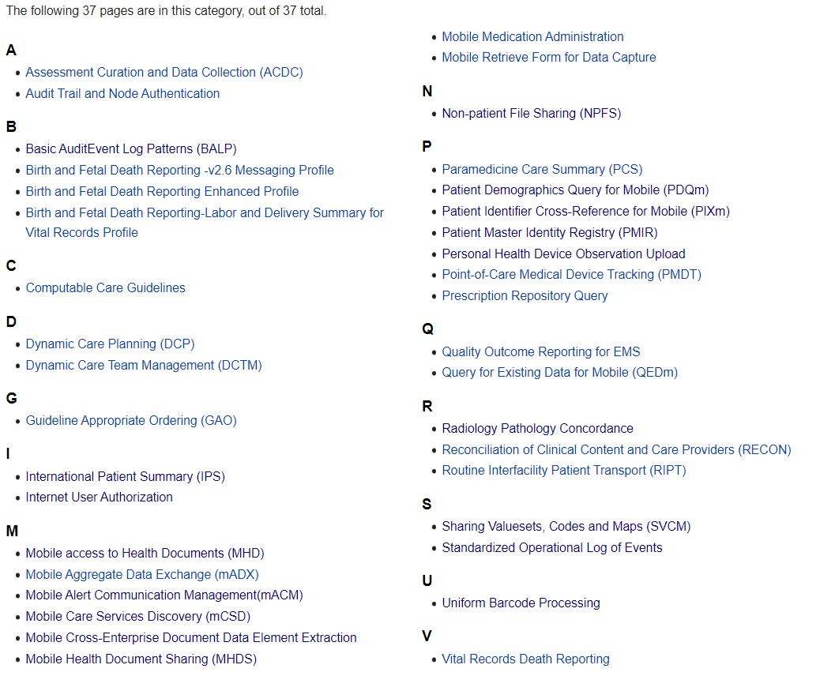
https://wiki.ihe.net/index.php/Category:FHIR

Slide 5
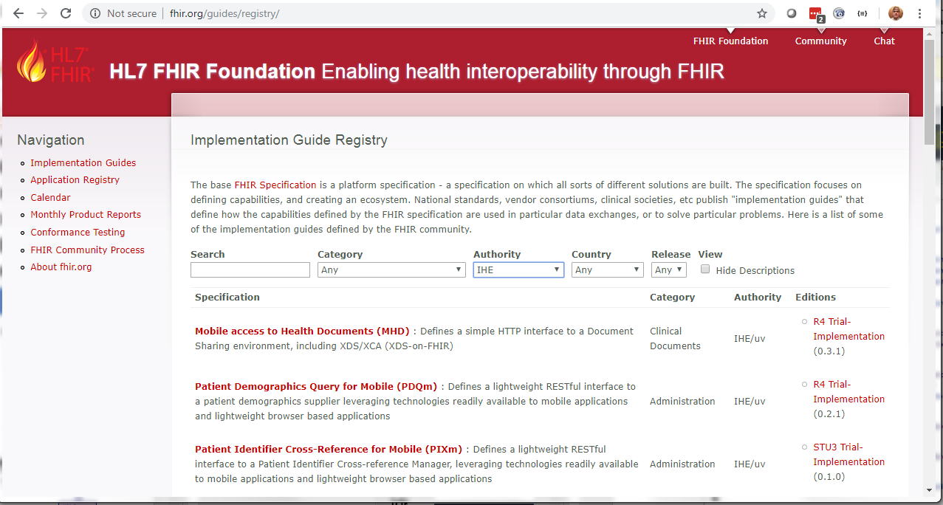
All are Registered on fhir.org

Slide 6
Many are published as Implementation Guides
Comprehensive FormatCode Vocabulary
Basic Audit Log Patterns (BALP)
Mobile Care Services Discovery (mCSD)
Mobile Access to Health Documents (MHD)
Mobile Health Document Sharing (MHDS)
Patient Demographics Query for Mobile (PDQm)
Patient Master Identity Registry (PMIR)
Patient Identifier Cross-reference for Mobile (PIXm)
Sharing Valuesets, Codes, and Maps (SVCM)
Interactive Multimedia Report (IMR)

Slide 7
IT Infrastructure Profiles
Audit Trail and Node Authentication (ATNA) – Feed & Query
Basic AuditEvent Log Patterns (BALP) 🌐 – AuditEvent content
Mobile Access to Health Documents (MHD) 🌐 – API
Mobile Health Document Sharing (MHDS) 🌐 - System
Mobile Care Services Discovery (mCSD) 🌐 - Provider Directory
Mobile Cross-Enterprise Doc Data Element Extraction (mXDE)
Non-patient File Sharing (NPFS)
Patient Identifier Cross-reference for Mobile (PIXm) 🌐 - API
Patient Demographic Query for Mobile (PDQm) 🌐 - API
Patient Master Identity Registry (PMIR) 🌐 – Patient Directory
Sharing Valuesets, Codes, and Maps (SVCM) 🌐 - Terminology
Mobile Alert Communication Management (mACM)
Internet User Authentication (IUA) – Special Mention
Notes:
[ATNA] Audit Trail and Node Authentication Basic security through (a) functional access controls, (b) defined security audit logging and (c) secure network communications.
[MHD] Mobile access to Health Documents provides a RESTful interface to Document Sharing including XDS.
[MHDS] Mobile Health Document Sharing (MHDS) provides a Document Sharing using only FHIR.
[mCSD] Mobile Care Services Discovery (mCSD) provides a RESTful interface to discover Care Services: Organization, Location, Practitioner, and Health Services.
[mXDE] Mobile Cross-Enterprise Document Data Element Extraction accesses data elements extracted from shared structured documents.
[NPFS] Non-patient File Sharing (NPFS) provides a RESTful interface enable sharing of non-patient files such as clinical workflow definitions, domain policies, and stylesheets.
[PDQm] Patient Demographics Query for Mobile (PDQm) provides a RESTful interface to a patient demographics supplier.
[PIXm] Patient Identifier Cross-Reference for Mobile (PIXm) provides a RESTful interface to patient identifier cross-references.
[PMIR] Patient Master Identity Registry (PMIR) provides a RESTful patient identity management.
[SVCM] Sharing Valuesets, Codes and Maps (SVCM) provides a RESTful access to ValueSets, CodeSystems, and ConceptMaps.
[mACM] Mobile Alert Communication Management(mACM) provides a RESTful interface to an alert infrastructure.
Not specific to FHIR, but used by all FHIR profiles [IUA] Internet User Authorization provides user authorization for RESTful interfaces.

Slide 8
Appendix Z on FHIR
Common text for all IHE Domains to re-use
Introduction to FHIR profiling concepts
Common query parameter clarifications
Relationship between CapabilityStatement and IHE Integration Statement
Pointer to library of conformance resources
Mapping of FHIR Identifier datatype to HL7 v3 root, and XDS Cxi
Security Considerations

Slide 9
Patient Care Coordination
Assessment Curation and Data Collection (ACDC)
Clinical Mapping (CMAP) → See ITI SVCM
Dynamic Care Planning (DCP)
Dynamic Care Team Management (DCTM)
Guideline Appropriate Ordering (GAO)
International Patient Summary (IPS)
Paramedicine Care Summary (PCS)
Point of Care Medical Device Tracking (PMDT)
Query for Existing Data for Mobile (QEDm)
Reconciliation of Clinical Content and Care Providers (RECON)
Routine Interfacility Patient Transport (RIPT)
Notes:
[ACDC] Assessment Curation and Data Collection distributes assessment instruments to healthcare providers and collects assessment results.
[CMAP] Clinical Mapping translates codes from one terminology to another for exchange of information between systems.
[DCP] Dynamic Care Planning shares and updates patient care plans.
[DCTM] Dynamic Care Team Management shares information about a patient's care teams.
[GAO] Guideline Appropriate Ordering supplies a mechanism by which EHR and departmental systems can evaluate orders to determine whether these orders conform to guidelines.
[IPS] International Patient Summary profiles IPS based on HL7's IPS Implementation Guides.
[PCS] Paramedicine Care Summary maps the flow of the patient information from the ambulance patient record, commonly known as the electronic Patient Care Record (ePCR), to the hospital Electronic Medical Record (EMR).
[PMDT] Point-of-Care Medical Device Tracking records medical device information acquired at the point-of-care.
[QEDm] Query for Existing Data for Mobile queries for clinical data elements (e.g. observations, allergies, conditions, diagnostic results, medications, immunizations, procedures, etc).
[RECON] Reconciliation of Clinical Content and Care Providers communicates lists of clinical data that were reconciled, who did the reconciliation and when.
[RIPT] Routine Interfacility Patient Transport supports interoperability between systems used on transport vehicles between healthcare facilities.

Slide 10
Devices
Personal Health Device Observation Upload (POU)
Notes:
[POU] Personal Health Device Observation Upload describes a standardized means of representing Personal Health Data (PHD) data as FHIR® Resources.

Slide 11
Pathology and Laboratory Medicine
Radiology Pathology Concordance (RPC)
Notes:
[RPC] - Radiology Pathology Concordance describes how discrete data elements are collected from structured reports to create an integrated report, where concordance of results is assessed, and reports are shared to an EMR or system in use by a health facility.

Slide 12
Pharmacy Profiles on FHIR
Mobile Medication Administration (MMA)
Uniform Barcode Processing (UBP)
Notes:
[MMA] Mobile Medication Administration connects EHRs with devices such as smartphones and smart pill boxes using RESTful web services.
[UBP] Uniform Barcode Processing returns a FHIR resource (for a medication, device, patient, etc) corresponding to a submitted barcode.

Slide 13
QRPH Profiles on FHIR
Birth and Fetal Death Reporting – Enhanced (BFDE)
Computable Care Guidelines (CCG) – draft only
Mobile Aggregate Data Exchange (mADX)
Mobile Retrieve Form for Data Capture (mRFD)
Prescription Repository Query (PRQ)
Quality Outcome Reporting for EMS (QORE)
Vital Records Death Reporting (VRDR)
Notes:
[BFDR-E] Birth and Fetal Death Reporting Enhanced Profile captures and communicates information for birth and fetal death reporting for vital registration purposes.
[CCG] Computable Care Guidelines encodes care guidelines in a format that can be understood by health software
[mADX] Mobile Aggregate Data Exchange (mADX) supports interoperable public health reporting of aggregate health data.
[mRFD] Mobile Retrieve Form for Data Capture describes the exchange of context data to allow a seamless form launch with supporting clinical context.
[PRQ] Prescription Repository Query (PRQ) defines a Retrieve query and HTTP GET transaction that specifies the dispensed medication history information that should be seen by primary care givers to assist in making an informed decision prior to prescribing additional medications to a patient.
[QORE] Quality Outcome Reporting for EMS describes content used for continuity of care between the emergency transport scene records and destination hospital where the emergency will be treated.
[VRDR] Vital Records Death Reporting defines a Retrieve Form for Data Capture (RFD) content profile that will specify derivation of source content from a medical summary document. by defining requirements for form filler content and form manager handling of the content.

Slide 14
Radiology Profiles on FHIR
Standardized Operational Log of Events (SOLE)
Interactive Multimedia Report (IMR) 🌐
Special mention as these use compatible DICOM web
Web Image Capture (WIC)
Web Image Access (WIA) formerly called MHD-I
Invoke Image Display (IID) - Special mention
Notes:
[SOLE] Standardized Operational Log of Events stores and retrieves logs of operational events (patient arrives, scan complete, etc.).
The Interactive Multimedia Report (IMR) Profile specifies how a diagnostic report with interactive multimedia content can be reliably encoded, communicated and presented.
Special mention for the RESTful standards from DICOM. These are not FHIR, but are using the same technology. These are used as an interface from FHIR to DICOM

Slide 15
Move to FHIR R4
All profiles are expected to be revised to use FHIR R4
All profiles will continue to be revised until the resources they use are Normative.
Candidate for Final Text: PDQm, PIXm, and Appendix Z
IHE Governance prevents normative until underlying standard is normative
R4B – may be called for in an IG that explicitly needs R4B
Expectation that any IG defined for R4 will work in R4B (none yet needed)
HL7 is trying to determine the specific concerns and alignment

Slide 16
IHE on FHIR
37 Profiles and growing
Devices - 1
IT Infrastructure (ITI) – 13 + 1
Pathology and Lab (PaLM) - 1
Patient Care Coordination – 10
Pharmacy - 2
Quality, Research and Public Health - 7
Radiology - 2

Slide 17
Questions?
John Moehrke
Gmail JohnMoehrke
Twitter JohnMoehrke
Skype johnmoehrke
Blog healthcareSecPrivacy.blogspot.com

